Slide 1

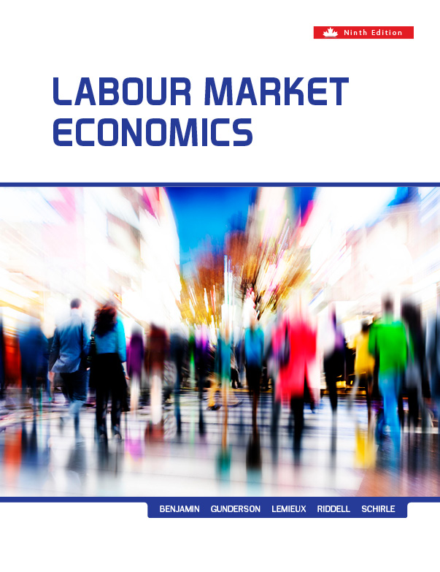
Chapter Eight
Compensating Wage Differentials
Prepared by Dr. Mir Ahasan Kabir
York University

Slide 2
Learning Objectives
Explain how labour market transactions between employers and employees are able to attach a “price” (compensating wage) to various attributes of a job, including working conditions, shift work, pension and health benefits, and risk.
Describe the conditions under which the market can yield an optimal amount of risk at the workplace, and the conditions under which that amount is not likely to be optimal.
Explain the conditions under which government health and safety regulations can affect the level of safety in the workplace in a way that either increases social welfare or decreases it.
© 2021 MCGRAW-HILL EDUCATION LTD.
8 - <number>

Slide 3
Learning Objectives
Discuss how there is “no such thing as a free lunch” in that workers generally “pay” for desirable workplace characteristics by accepting a lower wage in return for such characteristics.
Explain how estimates of the compensating wage premium that is paid for workplace risks can be used to provide estimates of the value of a (statistical) life.
© 2021 MCGRAW-HILL EDUCATION LTD.
8 - <number>

Slide 4
Main Questions
What factors determine the relative pay rates across different jobs?
Can workers with identical skills be paid different wages in the neoclassical model?
Does increased safety regulation make workers better off or worse off?
Are workers adequately compensated for performing unpleasant tasks or facing the risk of death on the job? Under what conditions might firefighters and police officers be paid the same, assuming their skills were equally valuable to society?
© 2021 MCGRAW-HILL EDUCATION LTD.
8 - <number>

Slide 5
Purposes of Wages and
Wage Structures
Wage Structure
  The hierarchy or grid of wage levels relative to each other
  A set of wage premiums associated with worker or job attributes
The Relationship between Wage and Productivity
The Social Role Related to the Wage and Wage Structure
© 2021 MCGRAW-HILL EDUCATION LTD.
8 - <number>

Slide 6
Theory of Compensating Wages
Factors affecting compensation for wages:
  Agreeableness/disagreeableness of job
  Ease/difficulty and cost of learning job
  Turnover in a particular job
  Degree of power and trust held
  Probability or improbability of success in job
  Safety risks involved in performing the job
© 2021 MCGRAW-HILL EDUCATION LTD.
8 - <number>

Slide 7
Theory of Compensating Wages
Isoprofit Schedule (I):
Combinations of wages and safety that the firm can provide and maintain the same level of profit
IP curve exhibits a diminishing marginal rate of transformation between wages and safety
Lower curves imply higher levels of profits
© 2021 MCGRAW-HILL EDUCATION LTD.
8 - <number>

Slide 8
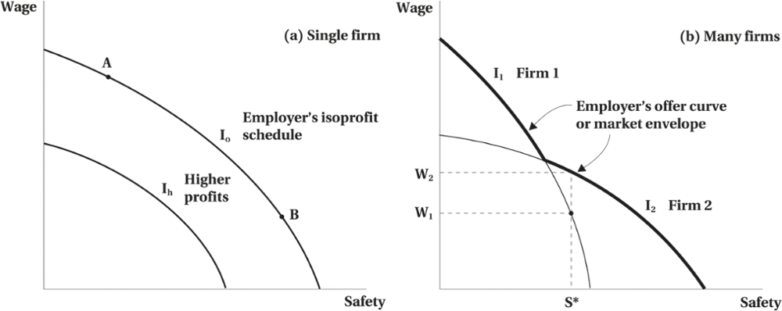
Theory of Compensating Wages
Figure 8.1 Employer’s Isoprofit Schedules and Offer Curve
© 2021 MCGRAW-HILL EDUCATION LTD.
8 - <number>

Slide 9
Theory of Compensating Wages
Different Firms with Different Safety Technologies
Different firms have different abilities to provide safety at a given cost and, hence, there are different isoprofit curves for the same level of profit for different firms.
© 2021 MCGRAW-HILL EDUCATION LTD.
8 - <number>

Slide 10
Theory of Compensating Wages
Individual’s Preferences
Illustrated by an iso-utility (indifference) curve
  Combinations of safety and wage that yield the same level of utility
Different risk preferences
May be willing to give up safety for a compensating risk premium
© 2021 MCGRAW-HILL EDUCATION LTD.
8 - <number>

Slide 11
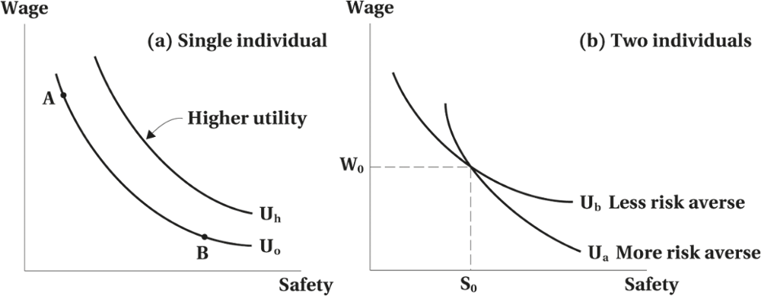
Theory of Compensating Wages
Figure 8.2 Worker Indifference Curves
© 2021 MCGRAW-HILL EDUCATION LTD.
8 - <number>

Slide 12
Theory of Compensating Wages
Equilibrium with Single Firm and a Single Individual
Tangency between the iso-utility curve and the isoprofit curve
Yields the optimal wage and safety level
© 2021 MCGRAW-HILL EDUCATION LTD.
8 - <number>

Slide 13
Theory of Compensating Wages
Equilibrium with Many Firms and Many Individuals
Assuming perfect competition
Individuals will sort themselves into firms of different risks
  Receive compensating wages
Wage-safety locus
  Various equilibrium combinations of wages and safety
© 2021 MCGRAW-HILL EDUCATION LTD.
8 - <number>

Slide 14
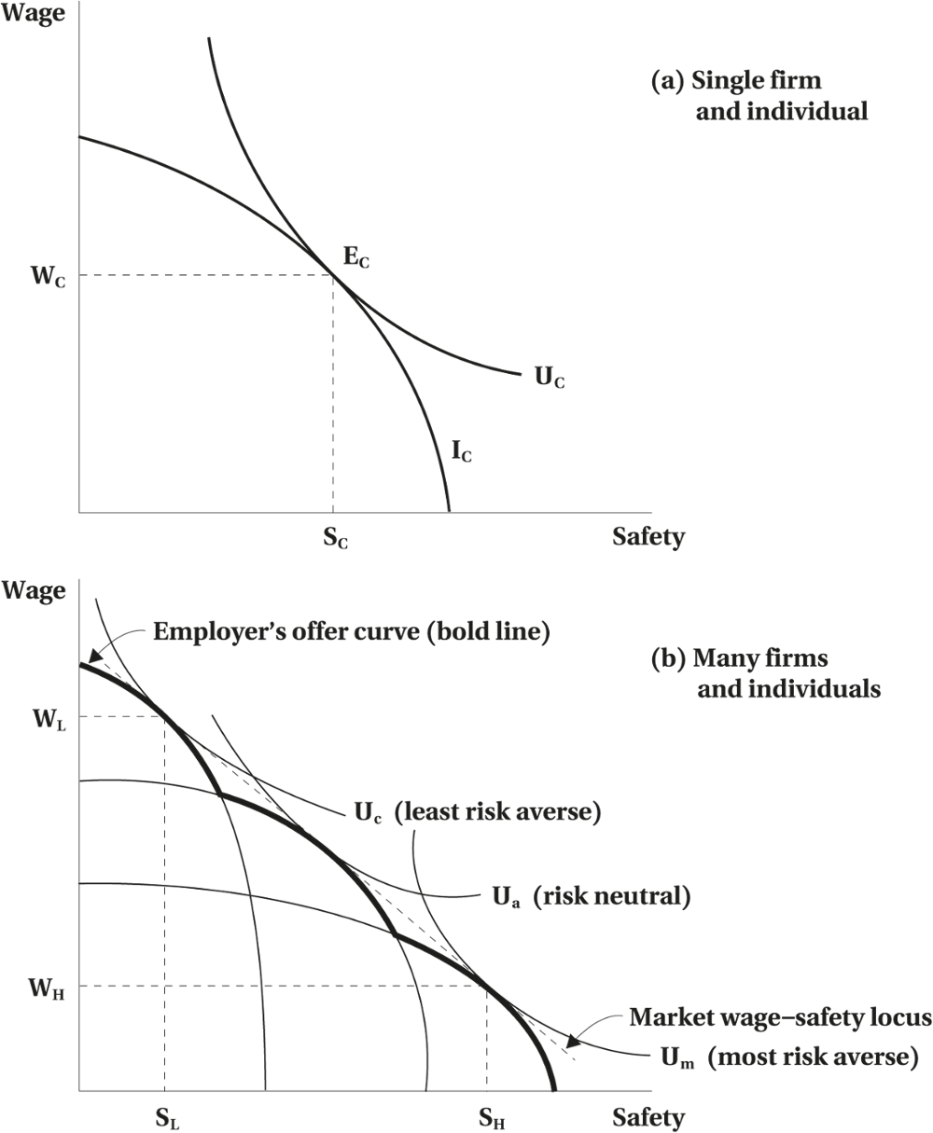
Theory of Compensating Wages
Figure 8.3 Market Equilibrium
© 2021 MCGRAW-HILL EDUCATION LTD.
8 - <number>

Slide 15
Theory of Compensating Wages
Characteristics of the Wage-Safety Locus
Slope is negative
  Compensating wages are required for reductions in safety
The slope can change for different levels of safety
Determined by the workers’ preferences and the firm's technology for safety
© 2021 MCGRAW-HILL EDUCATION LTD.
8 - <number>

Slide 16
Effect of Safety Regulation
Perfectly Competitive Markets
Regulation requiring an increased level of safety would cause one or both parties to be worse off.
© 2021 MCGRAW-HILL EDUCATION LTD.
8 - <number>

Slide 17
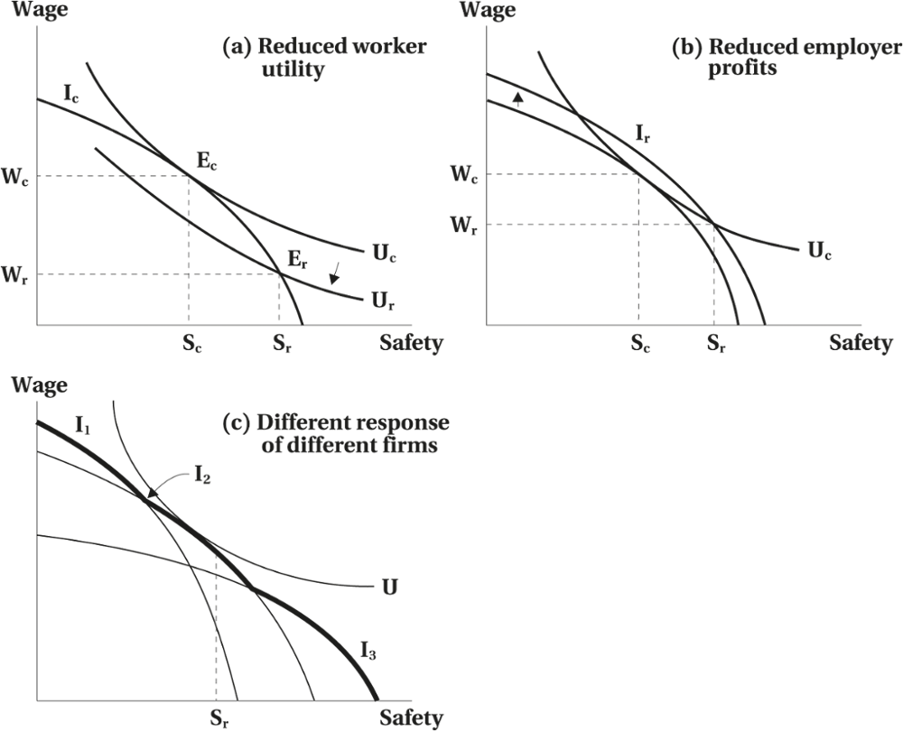
Effect of Safety Regulation
Figure 8.4 Responses to Safety Standard
© 2021 MCGRAW-HILL EDUCATION LTD.
8 - <number>

Slide 18
Effect of Safety Regulation
Worked Example
Attracting Doctors to Rural Communities
Both doctors can earn $100,000 a year when they set up their practice in an urban area.
Dr. Brown is willing to pay more than Dr. Lewis to live in a large city.
    Dr. Brown is indifferent between earning $190,000 in a rural area and $100,000 in a city.
    Dr. Lewis is indifferent between $140,000 in a rural area and $100,000 in a city.
© 2021 MCGRAW-HILL EDUCATION LTD.
8 - <number>

Slide 19
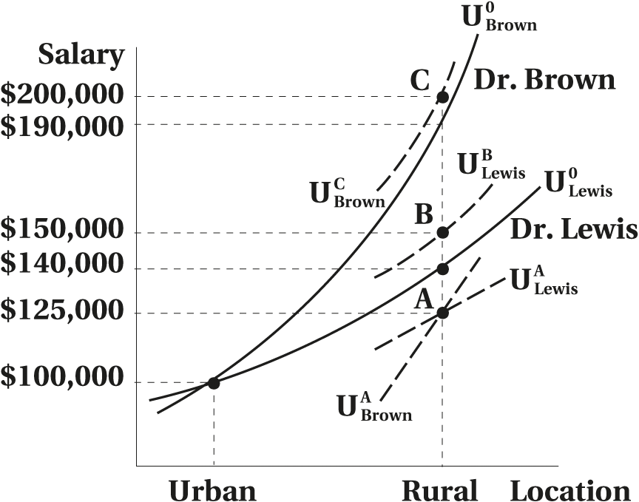
Effect of Safety Regulation
Location Decision of Dr. Lewis and Dr. Brown
© 2021 MCGRAW-HILL EDUCATION LTD.
8 - <number>

Slide 20
Effect of Safety Regulation
Imperfect Information
If a worker misperceives the utility, then the imposed safety standards could improve workers utility without making employers worse off
Providing parties with correct information would also lead to optimal amounts of safety
© 2021 MCGRAW-HILL EDUCATION LTD.
8 - <number>

Slide 21
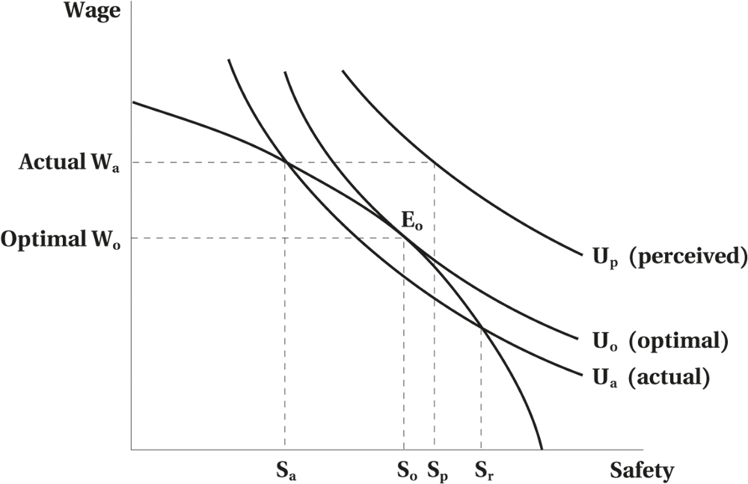
Effect of Safety Regulation
Figure 8.5 Effect of Imperfect Information
© 2021 MCGRAW-HILL EDUCATION LTD.
8 - <number>

Slide 22
Effect of Safety Regulation
Rationale for Regulation
Information is not perfect
Competition may not prevail
Worker does not bear all the cost of an accident
Social opinion
Worker may prefer a safer environment
© 2021 MCGRAW-HILL EDUCATION LTD.
8 - <number>

Slide 23
Effect of Safety Regulation
Safety Regulation: The Behavioural Economics View
Shiller’s (2005) Historical Perspective
Four Important Findings:
  “Risk as Feelings”
  “Hyperbolic Discounting”
  “Theory of Mental Departments”
  “Wishful Thinking Bias”
© 2021 MCGRAW-HILL EDUCATION LTD.
8 - <number>

Slide 24
Empirical Evidence on
Compensating Wages
Methodological Problems
  Simultaneous Equation Bias
  Errors-in-variables Problems
  Omitted Variable Bias
  Sample Selection Bias
© 2021 MCGRAW-HILL EDUCATION LTD.
8 - <number>

Slide 25
Empirical Evidence on
Compensating Wages
Wage-Risk Trade-offs and Value of Life
Compensating wage premiums are paid for work hazards.
They increase with the seriousness of the risk.
The wage premiums are reduced when the risk is partly covered by workers’ compensation systems.
© 2021 MCGRAW-HILL EDUCATION LTD.
8 - <number>

Slide 26
Empirical Evidence on
Compensating Wages
Desirable and Undesirable Job Characteristics
Compensating differentials associate with other elements of Smith’s first factor affecting relative wages.
Evidences of trade-off between health care benefits and wages.
© 2021 MCGRAW-HILL EDUCATION LTD.
8 - <number>

Slide 27
Empirical Evidence on
Compensating Wages
Employment Security
Address Smith’s conjectured third factor - compensating differentials for the risk of unemployment.
Challenge: the public provision of unemployment insurance
© 2021 MCGRAW-HILL EDUCATION LTD.
8 - <number>

Slide 28
Empirical Evidence on
Compensating Wages
Family-Friendly Work Practices
A substantial trade-off between pay and family-friendly work practices.
No trade-off for support for child care or for allowing working at home.
Mandated maternity leave has led to a drop in the wages of married women of childbearing age.
© 2021 MCGRAW-HILL EDUCATION LTD.
8 - <number>

Slide 29
Policy Implications
Regulations setting a uniform standard run the risk of making the parties worse off.
The realization of double compensation may reduce worker’s compensation and unemployment insurance.
Compensating wage differentials help us understand the existence and persistence of interoccupation, interindustry, and interregional wage structures.
© 2021 MCGRAW-HILL EDUCATION LTD.
8 - <number>

Slide 30
Chapter Summary
Wage differentials in an integrated labour market
Wage differences related to factors other than productivity aspects of jobs
A model of compensating wage differentials
Work safety and workers attitude towards work place risk
Market wage-safety locus
Empirical evidence
The impact of government regulation of work place safety
© 2021 MCGRAW-HILL EDUCATION LTD.
8 - <number>

